Slide 1
Computer Networks
CSE-AIT
Unit-02
Chapter 2.1
ALOK KUMAR – ASSISTANT PROFESSOR & KARGIL TECHINCAL TRAINER (DCPD)
EMAIL: DCPD.KARGILT1@CUMAIL.IN

Slide 2
Contents
Network Layer Design Issues & IP Addressing both Classful and Classless.
Subnetting and Supernetting.
Examples for Subnetting.
Forwarding of IP Packets.
IP Header and IPV4 and IPV6 Addressing.
Network Layer Protocols.

Slide 3
Where does the Network Layer come in?
The Network Layer is Layer 3 of the OSI model.
Its major responsibility is: To deliver packets from the source device to the destination device across one or more interconnected networks.

Slide 4
Network Layer Desing Issues / Responsibilities.
No. | Network Layer Responsibility / Design Issue | One-line Explanation
1 | Logical Addressing | Provides IP addresses to identify source and destination hosts/networks.
2 | Routing | Determines the best path through the network from source to destination.
3 | Forwarding | Sends a received packet through the correct outgoing interface toward its destination.
4 | Internetworking | Allows different networks to communicate and work together as one interconnected network.
5 | Packet Switching / Store-and-Forward | Routers receive, temporarily store, examine, and then forward packets.
6 | Connectionless / Datagram Service | Allows IP packets to be sent independently without establishing a connection first.

Slide 5
Network Layer Desing Issues / Responsibilities.
7 | Connection-Oriented Service | Provides a logical path/connection before packets are transferred, as in virtual-circuit networks.
8 | Fragmentation and Reassembly | Handles packets that are larger than the MTU supported by a network.
9 | Congestion Control / Traffic Management | Helps prevent excessive traffic from overwhelming network resources.
10 | Quality of Service (QoS) | Helps provide suitable treatment to traffic with different requirements such as delay or bandwidth.

Slide 6

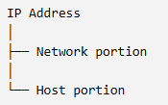
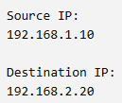
1. Logical Addressing
The Network Layer uses IP addresses to identify the source and destination of packets.
Why is this required?
For example:
A network may contain thousands or millions of devices.
The Network Layer needs a structured addressing system that tells routers: "Which network does this destination belong to?"
This is why IP addresses are divided conceptually into:
Suppose PC1 wants to send a packet to PC2.
The packet contains information such as:
The routers in between use the destination IP address to determine where the packet should go.
For example: 192.168.1.10
Network: 192.168.1.0
Host: 10

Slide 7
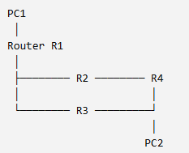
2. Routing
Routing is one of the most important responsibilities of the Network Layer.
Suppose we have:
PC1 wants to send a packet to PC2.
There are potentially multiple paths:
Path 1:PC1 → R1 → R2 → R4 → PC2
Path 2:PC1 → R1 → R3 → R4 → PC2
The router needs to determine: Which path should the packet take? This Process is called ROUTING

Slide 8
2. Routing
Routers use routing tables to make forwarding decisions.
For example:
Destination Network Next Hop
192.168.20.0/24 R2
192.168.30.0/24 R3
Routing protocols such as:
RIP
OSPF
EIGRP
BGP
can help routers learn routes

Slide 9
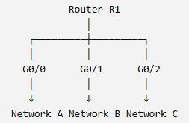

3. Forwarding
Routing and forwarding are related, but they are not the same thing.
Conceptually:
Routing asks: "Which path should be used?"
Forwarding asks: "Where should I send this packet next?"
Suppose Router R1 receives:
Destination IP: 192.168.20.10
Its routing table says:
If the destination is in Network B:
Packet - > G0/1.
R1 therefore forwards the packet through: G0/1

Slide 10
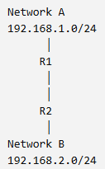
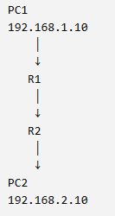
4. Internetworking
The word internetworking means connecting multiple independent networks so that devices on those networks can communicate.
For example:
These are two different IP networks.
Without Layer 3 routing, devices in Network A cannot directly communicate with devices in Network B.
The Network Layer provides the mechanisms that allow these different networks to communicate.
This is the basic idea behind an internetwork.

Slide 11
5. Packet Switching / Store-and-forward
At the Network Layer, data is carried in packets.
Consider: PC1 → R1 → R2 → R3 → PC2
Step 3 — Examines the packet
When R1 receives a packet, it generally:
It examines the IP header, particularly information such as:
Step 1 — Receives the packet
Source IP
Destination IP
TTL
Protocol
PC1 ───────→ R1
Step 2 — Stores/buffers it
Step 4 — Makes a forwarding decision
The router temporarily holds the packet.
The router checks its routing/forwarding information.
Step 5 — c
PC1 → R1 → R2
R2 performs a similar process.
This is called: Store-and-forward packet switching.

Slide 12
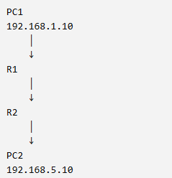
5. Packet Switching / Store-and-forward
Networking example
R1 doesn't simply send the packet blindly.
It receives the IP packet, determines the next hop, and forwards it.

Slide 13
6. Connectionless / Datagram Service
The Network Layer can conceptually provide connectionless service.
In a connectionless network: A connection does not have to be established before sending packets.
IP uses this model.
Suppose: PC1 → R1 → R2 → PC2
PC1 can create an IP packet:
Source IP: 192.168.1.10
Destination IP: 192.168.5.20 and sends it.
There is no requirement that PC1 first establish a dedicated network-layer connection with PC2.
Each IP packet is treated independently.
This is called: Datagram Service

Slide 14
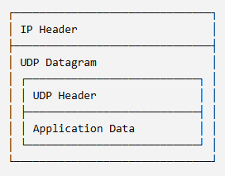
6. Connectionless / Datagram Service
For example:
Packet 1 → R1 → R2 → PC2
Packet 2 → R1 → R3 → PC2
Packet 3 → R1 → R2 → PC2
For example:
Conceptually, packets can potentially take different paths.
Important clarification
This does not mean UDP at the transport layer.
At Transport Layer: UDP -> UDP Datagram.
At Network Layer: IP -> IP Packet / IP Datagram.
They are different PDUs at different layers.

Slide 15
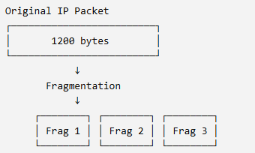
7. Fragmentation and Reassembly
Different networks can support different maximum packet sizes.
This maximum size is called: MTU (Maximum Transmission Unit)
Suppose:
Network A MTU = 1500 bytes
Network B MTU = 500 bytes
A Packet of: 1200 bytes can travel through network A. But it cannot fit into a network whose MTU is only 500 bytes.
Under IPv4, Fragmentation may be required.
The fragments are eventually reassembled at the destination.
Important IPv4/IPv6 distinction
IPv4: Routers can fragment packets under the IPv4 rules.
IPv6: Routers do not fragment packets in transit. The source must use the IPv6 fragmentation mechanism if fragmentation is necessary.

Slide 16
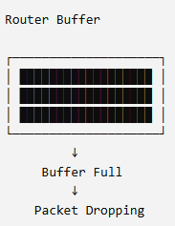
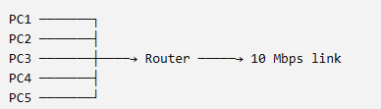
9. Congestion Control / Traffic Management
Now consider this situation:
Suppose the incoming traffic is: 100 Mbps but the outgoing link can only handle 10 Mbps.
The router cannot forward everything immediately.
At this moment, Packets starts accumulating in its buffer.
This is congestion.

Slide 17
9. Congestion Control / Traffic Management
Congestion can cause:
Increased delay
Packet loss
Buffer overflow
Reduced throughput
Retransmissions
Traffic shaping
One way to control the amount/rate of traffic entering the network is traffic shaping.
Two important algorithms are:
Leaky Bucket
Token Bucket

Slide 18
IP Addressing
Let’s recall the unit 1.
Every network interface has a MAC address.
For example:
PC1
MAC Address = 00:1A:2B:3C:4D:5E
Ques:
If every computer already has a MAC address, why do we need an IP address?
This is one of the most important questions in networking.
The answer is that MAC addressing and IP addressing solve different problems.

Slide 19

IP Addressing
MAC Address is a Layer 2 address
MAC addresses belong to the: Data Link Layer — Layer 2
For example: 00:1A:2B:3C:4D:5E
A switch uses MAC addresses to make forwarding decisions inside a Layer 2 network.
But what happens when the destination is on another network?
Consider: PC1 ───── Switch ───── PC2
PC1 wants to communicate with PC2.
The switch can learn:
and forward an Ethernet frame toward the appropriate port.
So MAC addresses are very useful for local network delivery.

Slide 20


IP Addressing
Now consider:
PC1 and PC2 belong to different IP networks.
The packet must travel through a router:
Now ask:
Can PC1 simply use PC2's MAC address to send the packet across the entire network?
NO
Suppose:
PC1 = 192.168.1.10
PC2 = 192.168.2.10
The MAC address is primarily used for local Layer 2 delivery. Routers operate at Layer 3 and use IP addressing to determine where a packet needs to go.
This is why we need: IP Addressing

Slide 21
IP Addressing
An IP address is a logical address assigned to a network interface so that devices can be identified and reached at the Network Layer.
For example: 192.168.1.10
Unlike a MAC address, which is associated with the network interface at Layer 2, an IP address is used to identify a device/interface within an IP network and can change when the device moves between networks.
Why is it called a logical address?
Eg:
Today you connect it to: University Network
It might receive: 192.168.10.25
Tomorrow you connect the same laptop to: Home Network
It might receive: 192.168.1.15
The laptop's network interface can retain the same MAC address, but its IP address can change according to the network it is connected to.

Slide 22
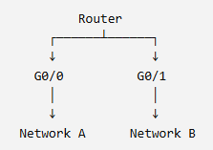
IP Addressing
A router can have multiple interfaces:
So:
MAC Address
↓
Associated with network interface
IP Address
↓
Associated with its location within an IP network
This logical structure is extremely important for routing.
For example:
G0/0 → 192.168.1.1
G0/1 → 192.168.2.1
IP address is not just "an address of a computer“
This is a subtle but important point.
We often casually say:
"PC1 has IP address 192.168.1.10."
But technically, an IP address is assigned to a network interface.
So the router has different IP addresses on different interfaces.
This makes sense because each interface connects to a different network.

Slide 23

IPv4 and IPV6
There are two major versions of IP: IPV4 and IPV6
Why are there four numbers?
IPv4
Internet Protocol version 4
Example:
192.168.1.10
IPv6
Internet Protocol version 6
Example:
2001:db8:abcd:0012::10
An IPv4 address contains: 32 bits
These 32 bits are divided into four groups of 8 bits.
Each 8-bit group is called an: OCTET
IPv4 and IPv6 are both Network Layer protocols.
IPv4 Address — Basic Structure
Therefore:
32 bits
↓
8 + 8 + 8 + 8
↓
4 octets
An IPv4 address is: 32 bits long.
For example: 192.168.1.10
looks like four decimal numbers, but internally the computer sees:
11000000.10101000.00000001.00001010

Slide 24
Each octet contains 8 bits.
The largest value that 8 bits can represent is: 11111111
In decimal: 128 + 64 + 32 + 16 + 8 + 4 + 2 + 1 = 255
The smallest value is: 00000000 = 0
Therefore, every IPv4 octet can contain: 0 to 255
So: 192.168.1.10 is a valid IP Address, but 192.168.1.300 is not
because 300 cannot be represented using 8 bits.
Example: 192.168.1.10
Convert each octet into binary:
192 = 11000000
168 = 10101000
1 = 00000001
10 = 00001010
11000000.10101000.00000001.00001010

Slide 25
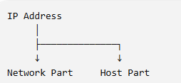

The most important concept: Network Part and Host Part
Example
An IP address has two conceptual parts:
Suppose we have:
192.168.1.10
and assume:
Network = 192.168.1.0
Then conceptually:
The: Network Part identifies which network the device belongs to.
The: Host Part identifies the particular host/interface within that network.
So:
192.168.1.10
means conceptually:
"Host 10 on the 192.168.1 network."
But there is an important problem:
How does the router know which bits belong to the network and which belong to the host?
This is where the subnet mask/prefix becomes important.

Slide 26
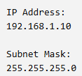

Subnet Mask
A subnet mask tells us which portion of an IPv4 address represents the: Network portion and which portion represents the: Host portion
For example:
Understanding /24
Remember: IPV4 = 32 bits
If we have, / 24, it means
24 bits -> Network
8 bits -> Host
Because: 32 – 24 = 8
The mask can also be written as: /24
So, 192.168.1.10/24 means, The first 24 bits represents the network portion.
In subnetting which we will study later, this thing is very imp.

Slide 27
Network Address VS Host Address
Let's take: 192.168.10.25/24
The Network is: 192.168.10.0 / 24
The Host is: 25
But there are special addresses within a network.
For example: 192.168.10.0 is the Network Address
and
192.168.10.255 is the broadcast address for that /24 network.
So typically the usable host addresses are:
192.168.10.1 to 192.168.10.254

Slide 28
Classful Addressing
IPv4 addresses were divided into different classes.
Example:
Imagine two organizations.
Organization A needs millions of hosts.
Organization B needs 100 hosts only.
Giving both organizations the same-size network would waste addresses.
So, IPV4 addresses were divided into classes of different sizes.
Class A → Very large networks
Class B → Medium-sized networks
Class C → Smaller networks
Class D → Multicast
Class E → Experimental/reserved
This was the original classful addressing system.

Slide 29

Class - A
Class A was designed for very large networks.
The first octet identifies the class and the remaining address space provides a very large host space.
The traditional range is:
1.0.0.0
to
126.255.255.255
The first octet is: 1 – 126
The default subnet mask is: 255.0.0.0 OR /8
Conceptually:
Therefore Class A had:
8 network bits
24 host bits
The host portion can theoretically provide: 2^24 addresses per network, though special addresses are reserved.

Slide 30
Class - A
Why doesn't Class A include 127?
The range: 127.0.0.0/8 is reserved for loopback.
For example: 127.0.0.1 is commonly used as the IPv4 loopback address. It refers back to the local host rather than being used as an ordinary network destination.
Therefore: Class A: 1 – 126 NOT 1 - 127

Slide 31


Class - A
Its structure is:
Therefore:
Network bits = 8
Host bits = 24
But there's something interesting here.
The first bit of a Class A address is fixed as: 0
So the actual structure is:
Therefore:
1 bit → Class identification
7 bits → Network ID
24 bits → Host ID
Total: 1 + 7 + 24 = 32

Slide 32
Class – A - Why does Class A start with 0?
This is where the Class A range comes from. A Class A address must begin with binary 0.
An 8-bit first octet looks like: 0xxxxxxx
The remaining 7 bits can be either 0 or 1. Hence,
The smallest possible value is: 00000000 Which is 0.
The Largest Possible value is: 01111111 Which is 127.
Therefore, the theoretical first-octet range is: 0 – 127
But not all of it is available for ordinary Class A network assignment.

Slide 33
Networks Possible in Class A
The first bit is fixed as 0. Therefore, only 7 bits remain for identifying networks.
So, 2^7 = 128 network numbers are possible.
But 0 and 127 are reserved.
Hence, 128 – 2 = 126

Slide 34
Host Possible in Class A
Class A has: 24 host bits.
Therefore, 2^24 possible host combinations.
But two addresses have special purposes in a conventional subnet:
All Host bits = 0. This represents the: Network Address
All Host bits = 1. This represents the: Broadcast Address.
Therefore, 2^24 – 2
16,777,216 – 2 = 16,777,214 usable hosts per traditional class A network.

Slide 35

Class - B
Class B was designed for medium-sized networks.
Traditional range:
128.0.0.0
to
191.255.255.255
First octet: 128 – 191
Default subnet mask: 255.255.0.0 OR /16
Conceptually:
Therefore: 16 network bits and 16 host bits
The theoretical number of addresses per Class B network is: 2^16=65,536 with two addresses traditionally unavailable for ordinary host assignment in a conventional subnet: Network Address & Broadcast Address.
So a conventional /16 network has: 65,536−2=65,534 usable host addresses.

Slide 36


Class - B
Its structure is:
But the first two bits are used to identify the class.
Class B starts with: 10, therefore,
So:
2 bits → Class identification
14 bits → Network ID
16 bits → Host ID
Total: 2 + 14 + 16 = 32

Slide 37
Class – B - Why does Class B start with 10?
The first two bits are fixed: 10
The remaining six bits of the first octet can vary.
So the first octet ranges from: 10000000 to 10111111
Minimum: 10000000 = 128
Maximum: 10111111 = 191
Therefore, range is: 128 - 191

Slide 38
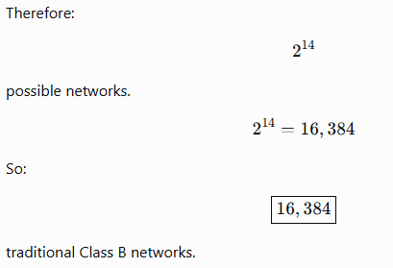
Networks Possible in Class B
We have: 14 bits → Network ID

Slide 39
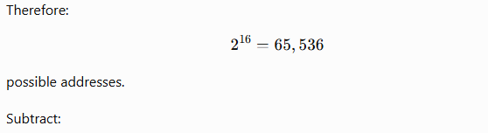
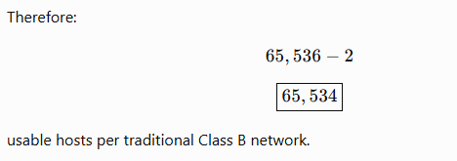
Host Possible in Class B
There are: 16 Host bits
1 Network address
1 Broadcast address

Slide 40

Class - C
Class C was designed for smaller networks.
Traditional range:
192.0.0.0
to
223.255.255.255
First octet: 192 – 223
Default subnet mask: 255.255.255.0 OR /24
Conceptually:
So: 24 network bits 8 host bits.
Theoretical addresses: 2^8=256
Usable host addresses: 256−2=254 for a conventional /24 subnet.

Slide 41

Class - C
Class C starts with: 110
Its structure is:
Therefore:
3 bits → Class identification
21 bits → Network ID
8 bits → Host ID
Total: 3 + 21 + 8 = 32

Slide 42
Class – C - Why does Class C start with 110?
The first three bits are fixed: 110
The remaining five bits can vary.
Therefore the first octet ranges from: 11000000 to 11011111.
Minimum: 11000000 = 192
Maximum: 11011111 = 223
Therefore, range is: 192 - 223

Slide 43
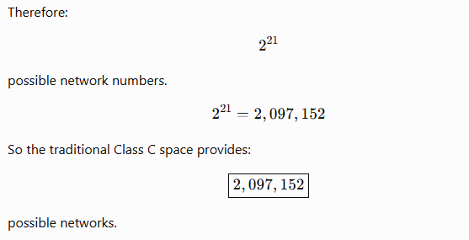
Networks Possible in Class C
Class C has: 21 Network bits

Slide 44
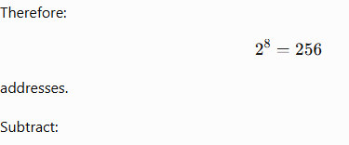
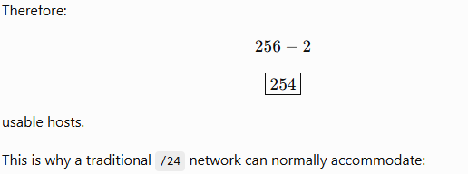
Host Possible in Class C
Class C has: 8 Host bits
Network address
Broadcast address

Slide 45
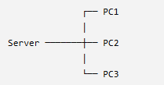
Class - D
Class D is different. It is used for MULTICAST.
Range:
224.0.0.0
to
239.255.255.255
It is not divided into the traditional network/host structure used by Classes A, B and C.
For example, multicast allows one sender to communicate with a group of receivers.
Conceptually:
Instead of sending three separate transmissions, multicast allows the sender to send to a multicast group.

Slide 46
Class - E
Class E historically covers:
240.0.0.0
to
255.255.255.255
It was reserved for: Experimental / reserved purposes.
It was not intended for ordinary host addressing.

Slide 47
Classful Addressing
Class | First Octet | Default Mask | Prefix | Purpose
A | 1–126 | 255.0.0.0 | /8 | Very large networks
B | 128–191 | 255.255.0.0 | /16 | Medium-sized networks
C | 192–223 | 255.255.255.0 | /24 | Smaller networks
D | 224–239 | — | — | Multicast
E | 240–255 | — | — | Experimental/reserved

Slide 48
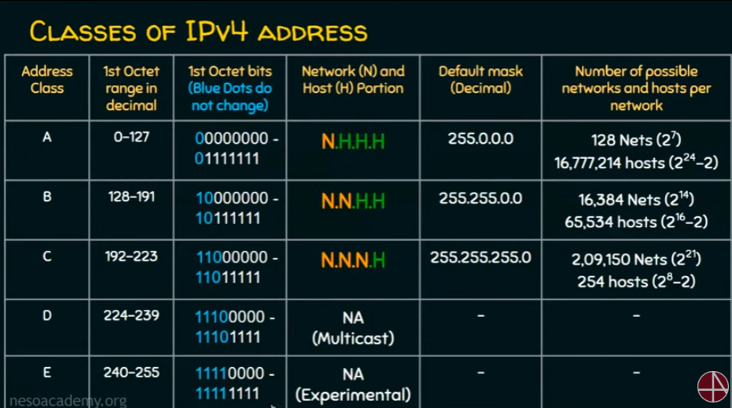
Classful Addressing

Slide 49
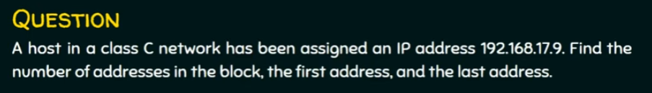
Practice Questions

Slide 50
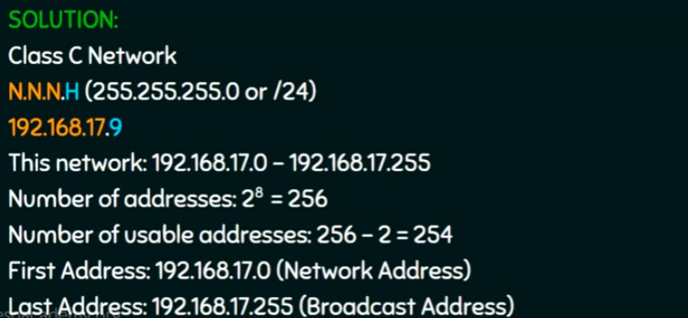

Slide 51
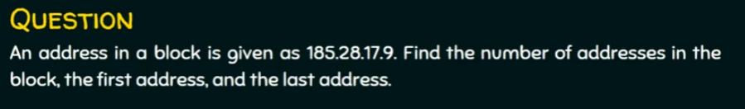

Slide 52
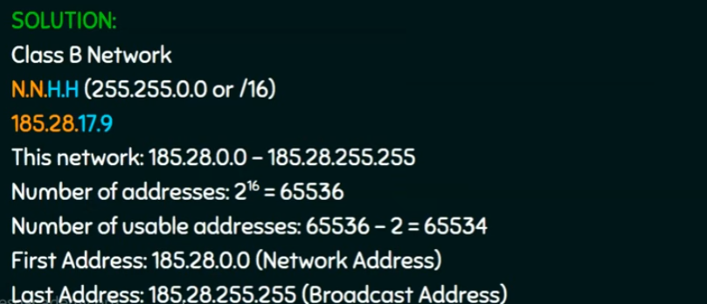

Slide 53
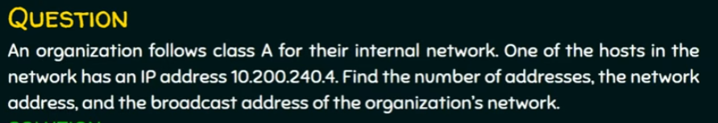

Slide 54
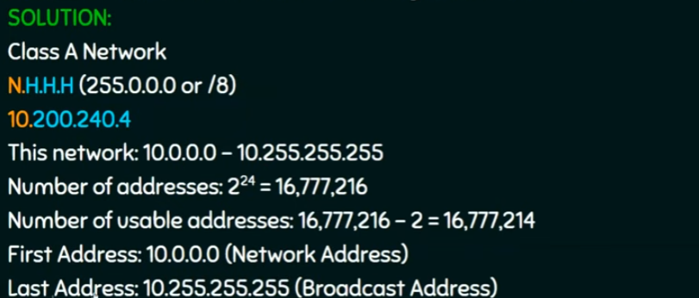

Slide 55
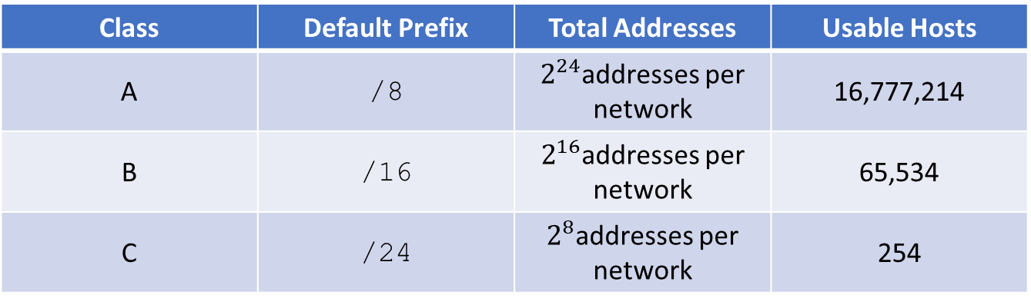
Problems in Classful Addressing
Class | Default Prefix | Total Addresses | Usable Hosts
A | /8 | $2^{24}$addresses per network | 16,777,214
B | /16 | $2^{16}$addresses per network | 65,534
C | /24 | $2^{8}$addresses per network | 254
In the classful system, we could not freely choose the network size.
We were mainly restricted to the default structures /8, /16, and /24.

Slide 56
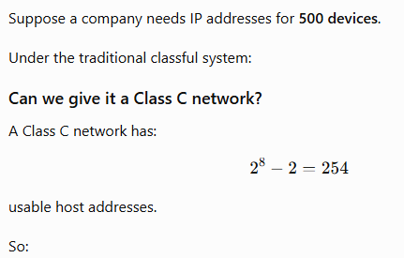
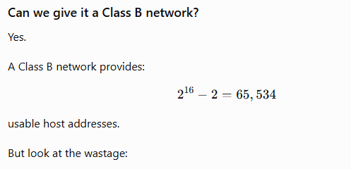
Problems in Classful Addressing
Required hosts = 500
Available in one Class C = 254
Therefore, one Class C network is not enough.
Company needs = 500 addresses
Class B provides = 65,534 addresses
Unused addresses = 65,034
So the organization gets a huge block even though it needs only a small portion.
This is called address wastage.

Slide 57
Solution – Classless Addressing
The main idea is simple:
Instead of forcing every network to use Class A, Class B, or Class C default sizes, we can choose the number of network bits according to the actual requirement.
For example, we can use:
We can also use:
/8
/16
/24
/17
/18
/19
/20
/21
/22
/23
/25
/26
/27
/28
/29
/30
but we are not limited to them.
This gives us much more flexibility.

Slide 58
What does “Classless actually mean?”
The word classless means that we no longer depend on the old Class A, Class B, and Class C boundaries to determine the network size.
For example, consider: 192.168.10.0
Under the old classful system, because 192 belongs to the traditional Class C range, we would normally associate it with:
Default prefix = /24
Default mask = 255.255.255.0
But under classless addressing, we can use the same address block with different prefix lengths, depending on the network design.
For example:
192.168.10.0/24
192.168.10.0/25
192.168.10.0/26
192.168.10.0/27
These represent different-sized networks.
Therefore: The IP address alone does not completely tell us the network size in classless addressing. The prefix length is also required.

Slide 59
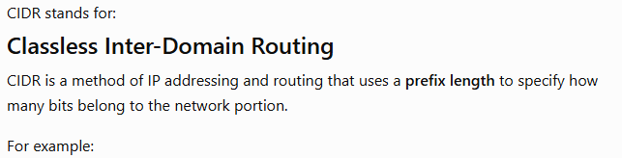

What is CIDR?
192.168.10.25/24
The /24 means: The first 24 bits belong to the network.
Therefore:
Network bits = 24
Host bits = 32 - 24 = 8
We can show this as:

Slide 60
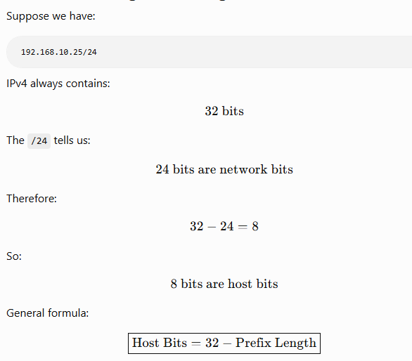
Understanding Prefix Length

Slide 61
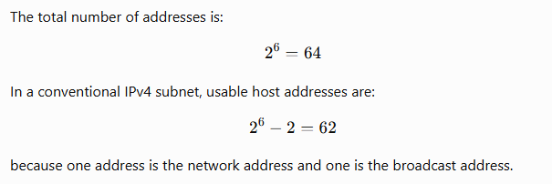
Example: What does /26 mean?
Consider:
192.168.10.25/26
First 26 bits → Network portion
Remaining 6 bits → Host portion
The /26 means:
Because: 32 – 26 = 6
Therefore:
Network bits = 26
Host bits = 6

Slide 62
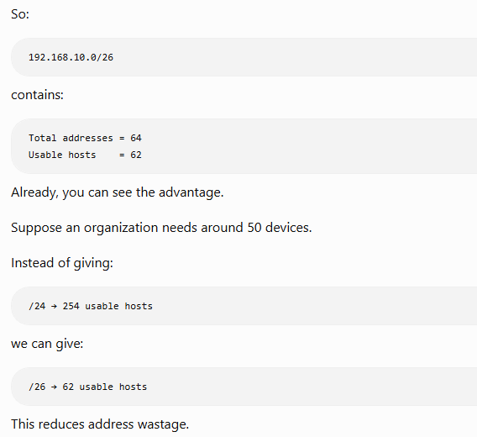
Example: What does /26 mean?

Slide 63
The Prefix is Written Using Slash Notation
CIDR uses: IP Address / Prefix Length
For example:
10.0.0.0/8
172.16.0.0/16
192.168.1.0/24
192.168.1.0/26
192.168.1.0/28
The number after / tells us: How many consecutive bits from the left are 1 in the subnet mask.
For example:
/24
means:
11111111.11111111.11111111.00000000
which is:
255.255.255.0
Similarly:
/16
means:
11111111.11111111.00000000.00000000
which is:
255.255.0.0

Slide 64
Understanding /26 in Binary
This is important because CIDR and subnetting are fundamentally based on binary.
A /26 means:
26 ones
6 zeros
Therefore:
11111111.11111111.11111111.11000000
So:
192.168.10.25/26
can also be written using the mask:
IP Address: 192.168.10.25
Subnet Mask: 255.255.255.192
Both represent the same network information
Let's divide it:
11111111 = 255
11111111 = 255
11111111 = 255
11000000 = 192
Therefore:
/26=255.255.255.192​

Slide 65
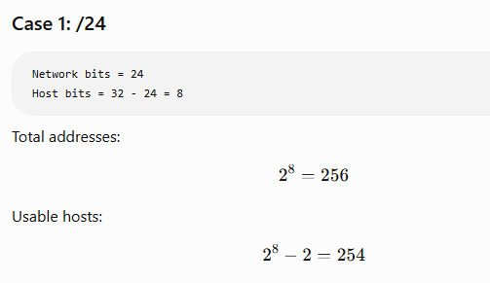
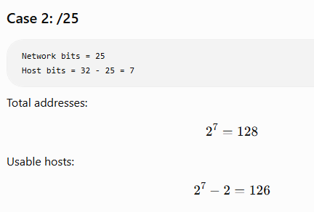
Why Does /25 Create a Different-Sized Network Than /24?
When we change: /24 → /25 we borrow one bit from the host portion.
Therefore:
/24
Network bits = 24
Host bits = 8
/25
Network bits = 25
Host bits = 7
becomes:

Slide 66
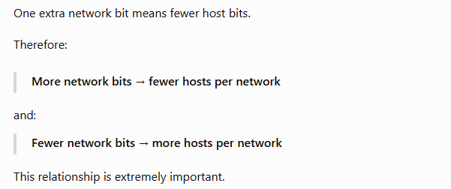
Why Does /25 Create a Different-Sized Network Than /24?

Slide 67
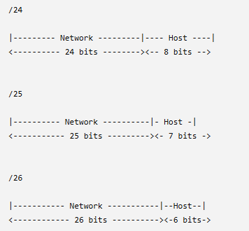
Visual Comparison
As the prefix increases:
/24 → /25 → /26 → /27
the network portion becomes larger.
The host portion becomes smaller.

Slide 68
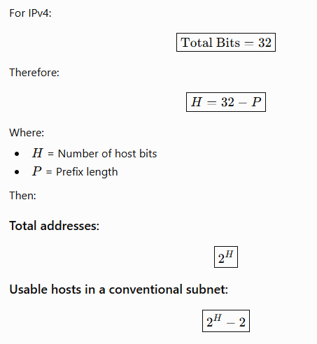
Important Formula

Slide 69
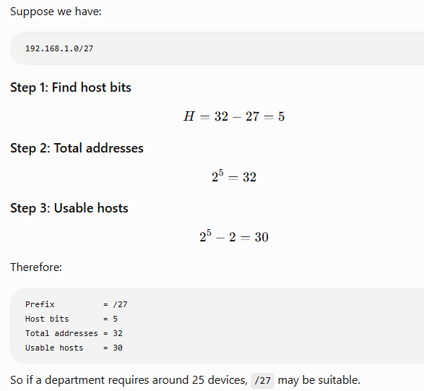
Example 1 — /27

Slide 70
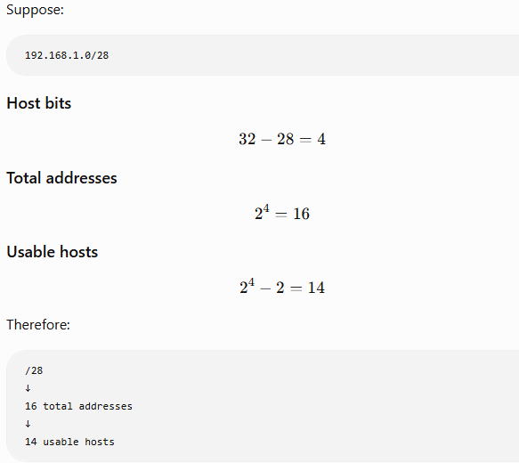
Example 2 — /28

Slide 71
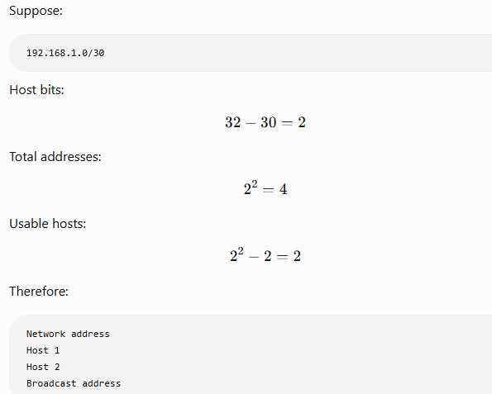
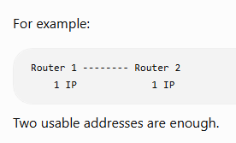
Example 3 — /30
This gives exactly:
2 usable host addresses
Traditionally, /30 has been commonly used for point-to-point IPv4 links, where two router interfaces need addresses.

Slide 72
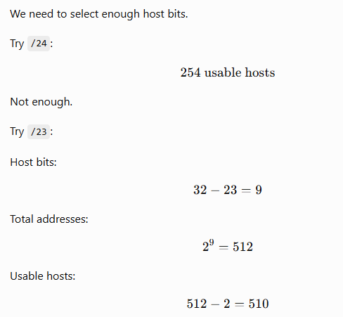
Back to the previous problem
500 hosts Requirement
Therefore:
/23 → 510 usable hosts
This is much more suitable for 500 hosts than assigning an entire Class B network with 65,534 usable addresses.
This demonstrates the real advantage of CIDR:

Slide 73
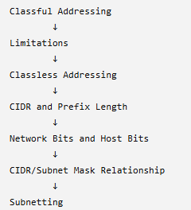
Difference: Classful vs Classless
The logical sequence should now be:
Feature | Classful Addressing | Classless Addressing/CIDR
Network size | Fixed by class | Flexible
Classes | A, B, C | Not dependent on classes
Prefix lengths | Traditionally /8, /16, /24 | Variable prefixes
Address allocation | Can waste many addresses | More efficient
Network size determined by | Class | Prefix length
Modern usage | Historical/legacy concept | Widely used

Slide 74
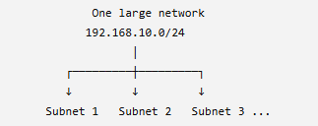
Subnetting
The word subnetting comes from: Sub-networking
That means: Taking one larger IP network and dividing it into multiple smaller networks called subnets.
Each smaller network is called a: Subnet

Slide 75
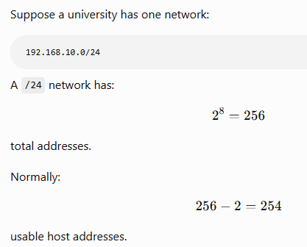
Why do we need subnetting?
Now imagine the university has three departments:
HR → 40 computers
Sales → 50 computers
IT → 100 computers

Slide 76
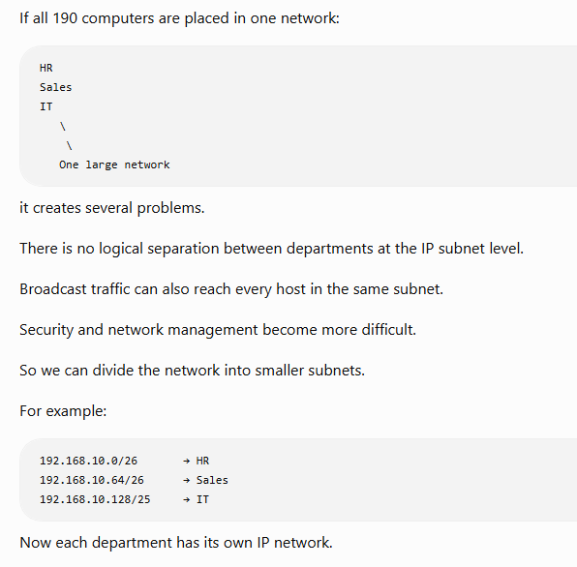

Slide 77
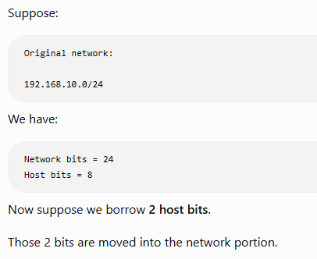


What does "borrowing host bits" actually mean?
Therefore: $24+2=26$
So the new prefix becomes: $\boxed{/26}$
And the remaining host bits become: $32−26=6$
This is the main thing in subnetting.

Slide 78

Why does borrowing bits create more subnets?
This is where binary becomes very useful.
Suppose we borrow 2 bits.
Those two bits can have four combinations:
00
01
10
11

Slide 79

What happens to the number of hosts?
So:
Original:
192.168.10.0/24
↓
254 usable hosts
Borrow 2 bits:
192.168.10.0/26
↓
4 subnets
↓
62 usable hosts per subnet

Slide 80


Eg:
Network bits increase
Host bits decrease

Slide 81

Now Let’s actually divide a network
Let’s take example of: 192.168.10.0/24
We want: 4 equal-sized subnets
How many bits do we need to borrow?

Slide 82

Find the new subnet mask
So:
192.168.10.0/26
has subnet mask:
255.255.255.192

Slide 83

Find the number of addresses per subnet

Slide 84

Find usable hosts per subnet

Slide 85

Now find the actual subnets
We have: 192.168.10.0/26
Mask: 255.255.255.192
The interesting octet is the fourth octet.
Why?
Because the first three octets are:
255.255.255
and the last octet is: 192

Slide 86

Now find the actual subnets
The Four Subnets will be:
Starting from 0 and increasing by 64:
0
64
128
192

Slide 87


Understanding Subnet 1

Slide 88

Understanding Subnet 2

Slide 89


Understanding Subnet 3 & 4

Slide 90
Subnet | Network Address | First Host | Last Host | Broadcast
1 | 192.168.10.0 | 192.168.10.1 | 192.168.10.62 | 192.168.10.63
2 | 192.168.10.64 | 192.168.10.65 | 192.168.10.126 | 192.168.10.127
3 | 192.168.10.128 | 192.168.10.129 | 192.168.10.190 | 192.168.10.191
4 | 192.168.10.192 | 192.168.10.193 | 192.168.10.254 | 192.168.10.255

Slide 91





Core Subnetting Formulas

Slide 92

Practice Question

Slide 93

Practice Question

Slide 94

Practice Question
Because:
192 = 11000000
So:
/26
11111111.11111111.11111111.11000000
There are 6 host bits remaining.

Slide 95

Practice Question

Slide 96

Practice Question

Slide 97

Practice Question

Slide 98

Practice Question

Slide 99

Practice Question

Slide 100


Practice Question

Slide 101


Practice Question

Slide 102


Slide 103
Given
IP Network:
216.21.5.0
The question does not specify a prefix, but 216 belongs to Class C, so under classful addressing the default prefix is: /24
Therefore:
Network bits = 24
Host bits = 8

Slide 104


Slide 105


Slide 106


Slide 107


Slide 108


Slide 109

Of these:
1 = Network address
30 = Usable host addresses
1 = Broadcast address
So:
32−2=30 usable hosts

Slide 110


Slide 111
Subnet | Network Address | Usable Host Range | Broadcast
1 | 216.21.5.0 | 216.21.5.1 – 216.21.5.30 | 216.21.5.31
2 | 216.21.5.32 | 216.21.5.33 – 216.21.5.62 | 216.21.5.63
3 | 216.21.5.64 | 216.21.5.65 – 216.21.5.94 | 216.21.5.95
4 | 216.21.5.96 | 216.21.5.97 – 216.21.5.126 | 216.21.5.127
5 | 216.21.5.128 | 216.21.5.129 – 216.21.5.158 | 216.21.5.159
6 | 216.21.5.160 | 216.21.5.161 – 216.21.5.190 | 216.21.5.191
7 | 216.21.5.192 | 216.21.5.193 – 216.21.5.222 | 216.21.5.223
8 | 216.21.5.224 | 216.21.5.225 – 216.21.5.254 | 216.21.5.255

Slide 112


Slide 113


Slide 114

So each subnet will have:
512 total addresses
510 usable host addresses

Slide 115


Slide 116

So we have:
Original host bits = 16
Borrowed bits = 7
Remaining host bits = 9
And:
7+9=16

Slide 117


Slide 118

Because the block size is 2 in the third octet, our subnet networks will increase by 2:
150.15.0.0
150.15.2.0
150.15.4.0
150.15.6.0
150.15.8.0
...

Slide 119


Slide 120


Slide 121
Subnet | Network Address | Usable Host Range | Broadcast
1 | 150.15.0.0 | 150.15.0.1 – 150.15.1.254 | 150.15.1.255
2 | 150.15.2.0 | 150.15.2.1 – 150.15.3.254 | 150.15.3.255
3 | 150.15.4.0 | 150.15.4.1 – 150.15.5.254 | 150.15.5.255
4 | 150.15.6.0 | 150.15.6.1 – 150.15.7.254 | 150.15.7.255
5 | 150.15.8.0 | 150.15.8.1 – 150.15.9.254 | 150.15.9.255
... | ... | ... | ...
127 | 150.15.252.0 | 150.15.252.1 – 150.15.253.254 | 150.15.253.255
128 | 150.15.254.0 | 150.15.254.1 – 150.15.255.254 | 150.15.255.255

